Slide 1
Python Part III: More on Functions
Lambda Expressions & Higher Order Functions
Dynamic Function Definitions:
Default Arguments
Keyword Arguments
Functions with Arbitrary Number of Argument

Slide 2
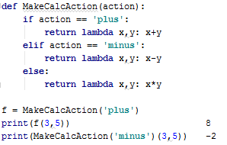
Lambda Expressions
Lambda expressions are used to return a function object
This concept correlates with higher-order functions
It is similar to function pointers (C++), delegates (C#), and event handlers

Slide 3


Higher Order Functions
map() takes a function and a list, and returns a new list by running the function on all the list members
It can also be shorter with lambda expressions
If the function gets 2 parameters, then map expects 2 lists to be provided
Notes:
הערה: map בגירסאות מתקדמות של פייתון מחזיר אובייקט מסוג map ולא list ולכן נצטרך לעשות casting.

Slide 4


Higher Order Functions (2)
reduce() shrinks a list into a single element by calling a function on the lists members:
The function starts its execution on the first 2 elements
Then it executes on the result with the third element, …
filter() filters a list according to a boolean function

Slide 5

Higher Order Functions Exercises
What will be the output?
What does mystery() do?
Write a function filter_long_words() that takes a list of words and an integer n and returns the list of words that are longer than n.
Write a function find_longest_word() that takes a list of words and returns the length of the longest one. Use only higher order functions.
Notes:
פונקציה מסתורית בודקת האם המספר ראשוני או לא.
נשים לב ש-0 נחשב לערך שקרי כאשר מדובר בפעולה בוליאנית/לוגית כמו and,or וכולי סביר להניח שכל ערך אחר לאמת... לדוגמא:
1and2 = True --->1
5and3 = True
1and0 or 0and5 = False or False = False --->0

Slide 6
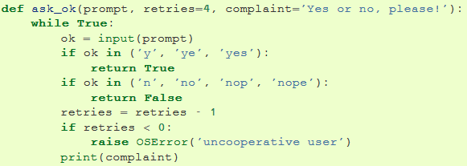
Default Arguments Values
Function arguments can contain default values:
The first arg is mandatory, and order is important
ask_ok('Do you really want to quit?')
ask_ok('OK to overwrite the file?', 2)
ask_ok('OK to overwrite the file?', 2, ‘Just yes or no!')

Slide 7
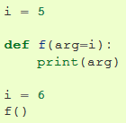
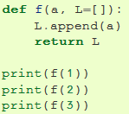


Default Arguments Values (2)
Default values are evaluated when the function is defined
Default values are evaluated only once
To avoid the default value from being shared between calls, rewrite the function like this:
5

Slide 8

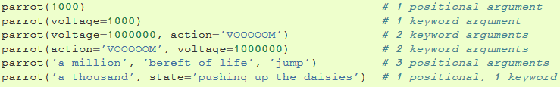
Keyword Arguments
Functions can also be called using keyword arguments of the form kwarg=value. For instance:
parrot() accepts one required argument (voltage) and three optional arguments (state, action, and type)
It can be called in any of the following ways:

Slide 9

Keyword Arguments Rules
Keyword args must follow positional args
The order of keyword args is not important
Unless called as positional args
Only args declared by the function are accepted
Positional args can be called as keyword args
No arg may receive a value more than once
The following calls to parrot() are invalid:

Slide 10
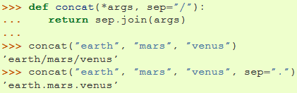
Arbitrary Number of Arguments
Python’s dynamic function definition: Functions can be called with an arbitrary number of arguments
They appear as a single argument prefixed by * (i.e. *args)
They are wrapped in a tuple accessible in the function
Before *args, positional arguments may occur
After *args, only keyword arguments may occur
Notes:
הגיוני לבנות את "אינסוף" הפרמטרים ב-tuple מאחר ולרוב לא נרצה לשנות את הפרמטרים לפונקצייה
דוגמא לפונקצייה מוכרת שממשת את הרעיון היא print , אגב כמעט בכל השפות המימוש הינו כזה...

Slide 11
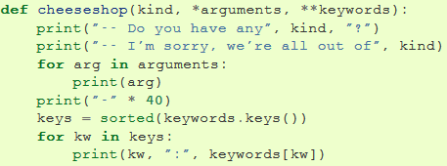
Arbitrary Number of Arguments (2)
*args wraps all positional args
Similarly, **keywords wraps all keyword args
They are wrapped in a dictionary
Since positional args must precede keywords args, then *args must precede **keywords

Slide 12

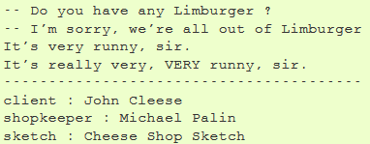
Arbitrary Number of Arguments (3)
The cheeseshop() function can be called like this:
And will print:

Slide 13
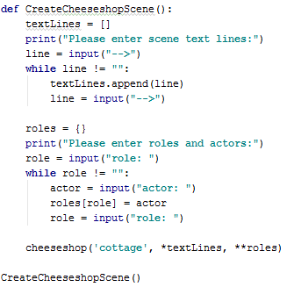
Unpacking Argument Lists
If our args are already in a list, we can call the function with the list prefixed with *
This will unpack the list elements to positional args
Similarly, we can call the function with a dictionary prefixed with ** to unpack the keyword args

